Slide 1
BOĞAZİÇİ UNIVERSITY
FACULTY OF MANAGERIAL SCIENCES
Department of Tourism Administration
2023

Slide 2
The Department of Tourism Administration at Boğaziçi University, whose roots go back to 1976, includes a 4-year English-taught undergraduate program that accepts the highest-ranked students in Turkey in the fields of tourism, travel and accommodation management.
In addition to our undergraduate and master’s program, a PhD program is now offered.
In line with Boğaziçi University’s strategic goals, the Department aims to become an educational institution that is globally recognized with its academic successes and the quality of education, and which makes contributions to the general welfare and development of society.

Slide 3
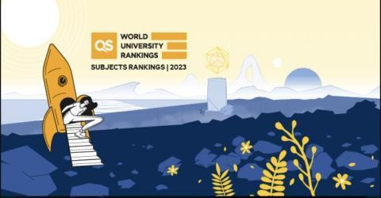
Quacquarelli Symonds(QS) 2023 Subject-Based World University Rankings
According to the QS 2023 Subject-Based World University Ranking results, Boğaziçi University Department of Tourism Administration is among the top 150 universities worldwide.

Slide 4
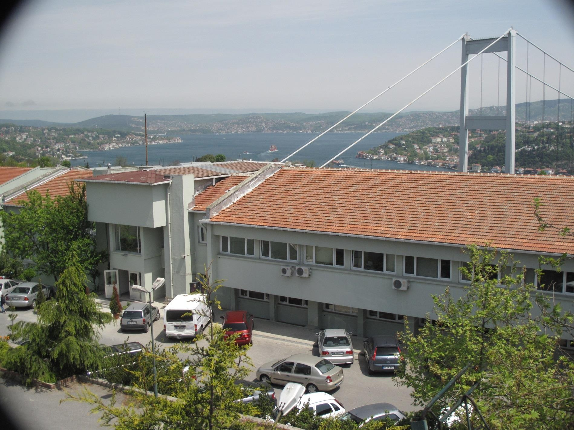

Slide 5
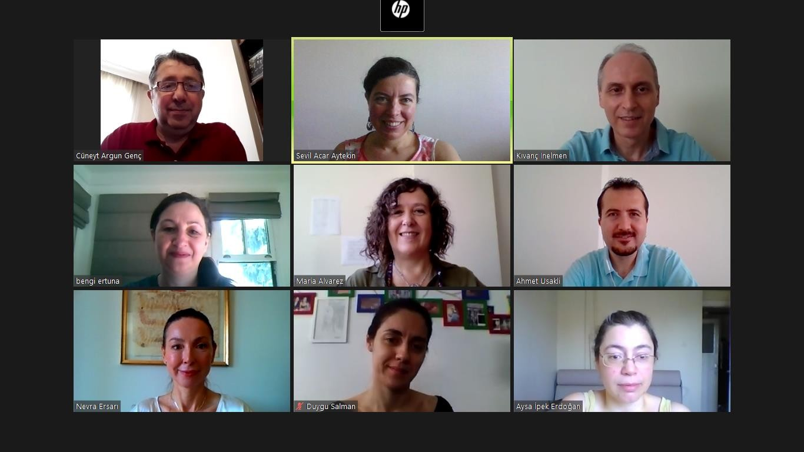
ACADEMIC STAFF
We have 11 full-time academicians (5 Professors, 2 Associate Professors, 2 Assistant Professors, 2 Lecturers), 2 Research Assistants, and many part-time Lecturers from the industry, all with degrees from reputable universities.

Slide 6
ACADEMIC STAFF
FULL TIME
Prof. Sevil Acar
Prof. Maria Dolores Alvarez
Prof. Aysa İpek Erdoğan
Prof. Bengi Ertuna
Prof. Kıvanç İnelmen
Assoc. Prof. Ezgi Erkmen
Assoc. Prof. Ahmet Uşaklı
Assist. Prof. Evinç Doğan
Assist. Prof. Duygu Salman- Öztürk
Lecturer Dr. Nevra Ersarı
Lecturer Cüneyt Argun Genç
Res. Assist. Ceren İlayda Başol
Res. Assist. Muteber Tuzcu
PART TIME
Dr. Akgün İlhan
Lawyer İlker Ünsever
Eylem Atalay
Petek Göker Erkose
Arif Kılınçarslan
Özlem Kınık
Burçak Gülen Morhayım
Mustafa Devrim Yalçın

Slide 7
OUR PROJECTS AND STRATEGIC PARTNERSHIPS
Situation Analysis Roadmap for Tourism Development in Cappadocia prepared for AHİLER Development Agency
Thrace Sustainable Tourism Master Plan, prepared jointly with the Thrace Development Agency
‘Sustainable Tourism’ project with the UNDP and Anadolu Efes
European Union project on “Improving the Quality of Food and Beverage Vocational Education Schools in the Thrace Region" "360 Degrees View of Istanbul Hotels" jointly run with TUROB
Sustainable tourism development projects organized continuously with San Diego State University
Joint project with George Washington University, supported by the UNWTO

Slide 8
COURSES
Tourism and travel industry: 18 courses
Business and management: 18 courses
Law and social sciences: 12 courses
Economics and finance: 6 courses
Math and statistics: 4 courses
Foreign language: (minimum) 4 courses
Research and project: 2 courses

Slide 9
PROGRAM - FRESHMAN
SEMESTER 1
Math 1
Introduction to Tourism Industry
Anatolian Civilizations
Economics 1
Introduction to Psychology
Elective
SEMESTER 2
Math 2
Environment and Tourism
Business Communication
Economics 2
Principles of Management
Elective

Slide 10
PROGRAM - SOPHOMORE
SEMESTER 1
Accommodation Industry
Financial Accounting
Introduction to Law
Applied Statistics I
Principles of Marketing
Foreign Language
Turkish I
SEMESTER 2
Interpersonal Communication
Managerial Accounting for Tourism Industry
Tourism Law
Applied Statistics II
Travel Industry
Foreign Language
Turkish II

Slide 11
PROGRAM - JUNIOR
SEMESTER 1
Management of Human Resources
Introduction to Finance
Research Methodology
Departmental Elective
Foreign Language
Hist. of Turk. Rep. I
SEMESTER 2
Organizational Behavior
Services Marketing
Food Service Management
Departmental Elective
Foreign Language
Hist. of Turk. Rep. II

Slide 12
PROGRAM - SENIOR
SEMESTER 1
Conventions and Special Events
Business Ethics
Tourism Destination Development
Departmental Elective
Complementary Elective
SEMESTER 2
Operations Research for Service Industry
Business Strategy
Tourism Research Project
Departmental Elective
Complementary Elective

Slide 13
DEPARTMENTAL ELECTIVES
Professional Communication
Ancient Cities and Tourism
Anatolian Mythologies
Cruiseline and Marina Operations
Learning Organizations
Cultural Tourism
Food Science and Nutrition
International Cuisines
Recreation and Leisure Management
Diversity Management
Airline Management
Travel Geography
Current Issues in Tourism
Introduction to Professional Life
Social Aspects of Tourism
History of Civilizations
Entrepreneurship
Promotion of Services
Information Systems for Tourism Industry
Sociology of Food
Tourism Safety and Security Management
Sanitation and Hygiene
Consumer Behavior
Special Interest Tourism
E-Marketing
Corporate Consultancy
Economic Issues in Tourism

Slide 14
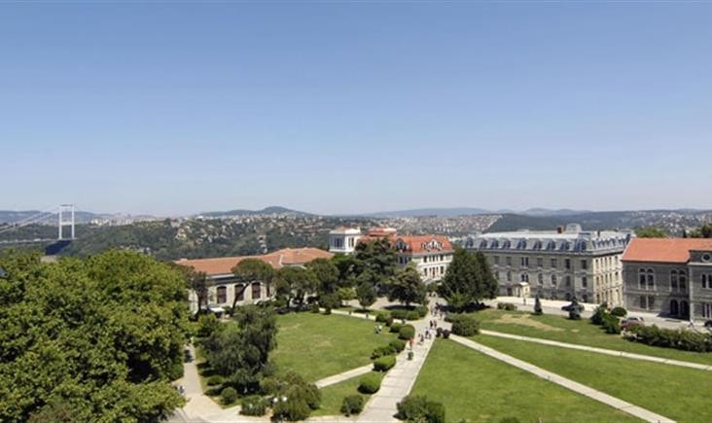
PRINCIPLES AND MANAGEMENT APPROACH
Our department maintains its research and education programs in accordance with the scientific and educational standards of Boğaziçi University and by adhering to the highest ethical values.
It is a part of an extensive international network.
It is a member of the UNWTO Knowledge Network.

Slide 15
EXCHANGE/ERASMUS
The students of our department can temporarily study at many universities within the scope of Erasmus or special exchange programs
The universities that the department has aggreements with:
George Washington University, USA
San Diego State University, USA
Modul University Vienna, Austria
Bremen University of Applied Sciences, Germany
Dortmund Int. School of Management, Germany
La Rochelle, Business School, France
Breda University, Holland
Saxion University, Holland
Universidad Autonoma de Madrid, Spain
Universidad de Girona, Spain
University of Wroclaw, Poland
Bournemouth University, England
Robert Gordon University / Aberdeen, England
Further info can be obtained from the Office of International Relations: http://www.intl.boun.edu.tr/

Slide 16
INTERNSHIP
Our students have the opportunity to experience the dynamics of the sector by completing their internships in hotels or travel and tourism companies for two months in the summer following their 2nd or 3rd grades. Some examples:
Conrad
Four Seasons
Hilton Hotels
DoubleTree
Hyatt Regency
Çırağan Palace
W İstanbul
Pera Palace
TUROB
Culture and Tourism Ministry
Turkish Airlines
Turkish Do&Co
Çelebi Air
ETS
Setur
VIP
Booking.com
Expedia
Lütfi Kırdar International Congress and Exhibition Centre
İKSV

Slide 17
DOUBLE MAJOR PROGRAMS
Our students can attend double major programs to receive diplomas from both majors with the following:
International Trade
Management Information Systems
Minor-degree certifications can be obtained from different departments of the University.

Slide 18
OUR ALUMNI
Also our graduates who preferred to enter business life work in prestigous foundations. Some examples from the sector:
Hotels (selected):
Hilton Hotels
Hyatt Regency Hotel
Ritz-Carlton
Swissotel
Le Meridien Hotel
Raffles Hotel
Culture and Tourism Ministry
Turkish Airline
Lütfi Kırdar International Congress and Exhibition Centre
Travel Agencies (VIP Turizm, vs..)
Online Travel Agencies
(Booking.com, Expedia)
BTA Catering
İKSV
Non-governmental organizations

Slide 19
OUR ALUMNI
Examples from outside the tourism industry:
Abdi İbrahim, Novartis, Pfizer (Events and Organizations)
Vodafone, Avea, Turkcell
Coca Cola, L’Oréal, Danone, LG
Boston Consulting Group, Deloitte
American Hospital, Acıbadem Hospital
Various banking companies
Students’ own businesses in the areas of:
E-trade, digital marketing, product design

Slide 20
OUR ALUMNI
Some of our graduates continue their education to obtain their master’s and PhD degrees at reputable universities.
London School of Economics
University College London
New York University
University of South Florida
Pennsylvania State University
Oklahoma State University
Portland State University
Stockholm School of
Economics
University of Amsterdam
Vrije University Amsterdam
Baruch College and others
Some examples:
Boğaziçi University
İTÜ
METU
Galatasaray University
Koç University and others

Slide 21
MASTER’S PROGRAM
Some of the suggested courses in the Sustainable Tourism Management Master’s Program :
Tourism, Society and Culture
Environment, Sustainability and Tourism
Operations Research in Tourism
Tourism Destination Development
Sustainable Business Management
Anthropology and Tourism
Social Responsibility and Governance
Sustainable Human Resources
Cultural Heritage
Rural Tourism
Qualitative Research Techniques

Slide 22
BOĞAZİÇİ UNIVERSITY FACULTY OF MANAGERIAL SCIENCES
Department of Tourism Administration
For further information:
www.tourism.boun.edu.tr
trm@boun.edu.tr

